Slide 1
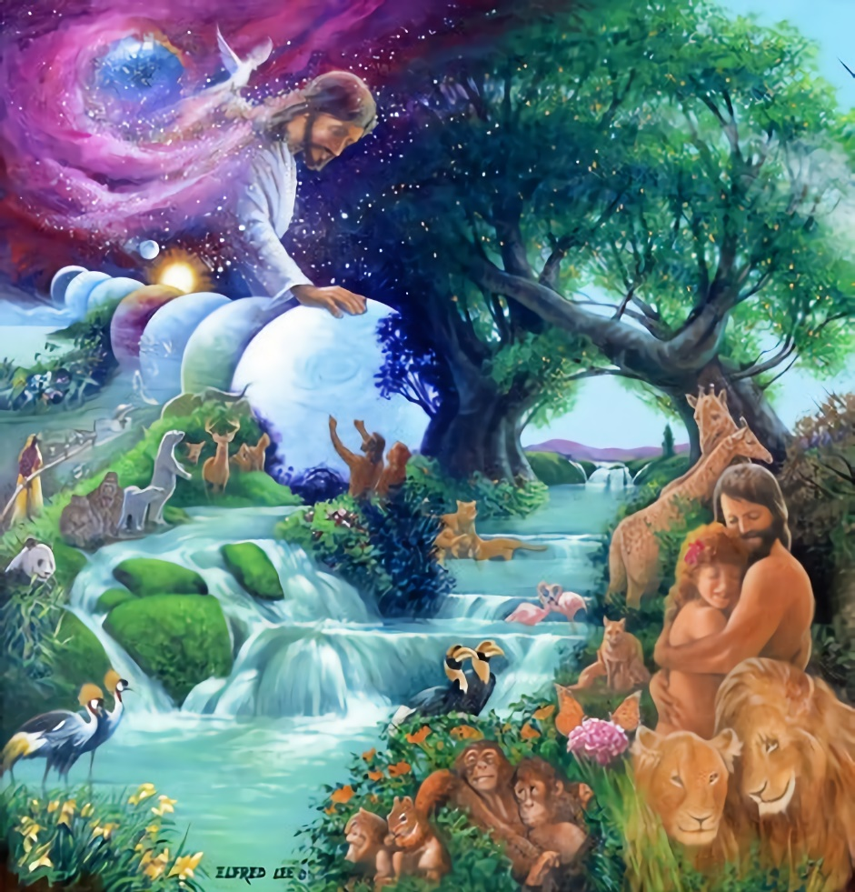
THE RHYTHMS OF REST
Lesson 9 for August 28, 2021

Slide 2
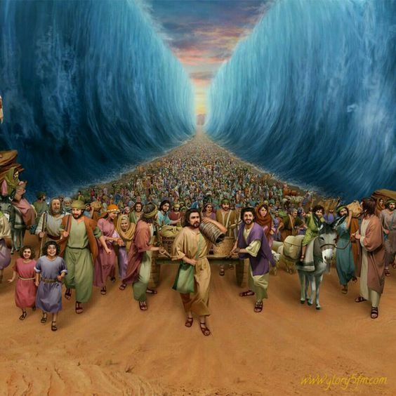
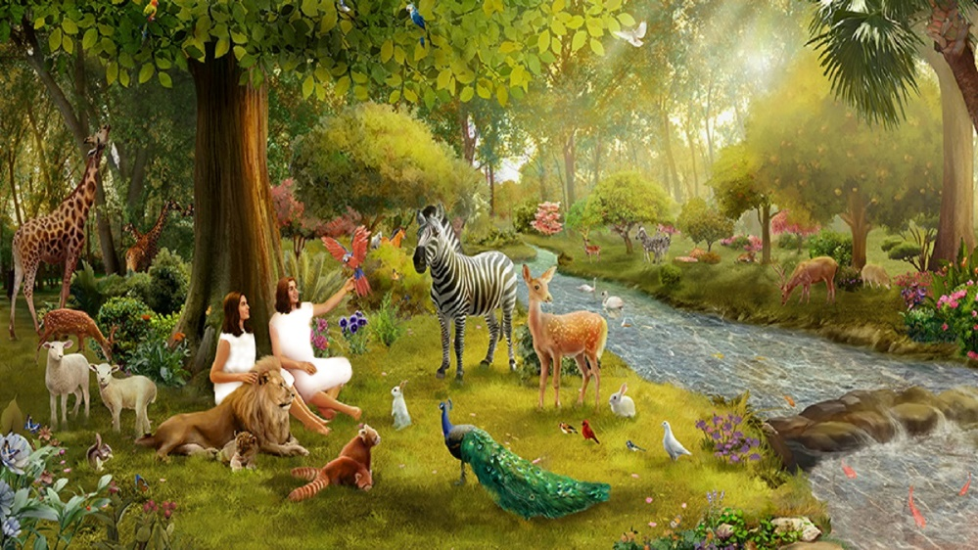
The Sabbath reminds us that God created us and that He is able to liberate us and redeem us. The Almighty Creator that liberated Israel from slavery in Egypt can liberate us from the sin that enslaves us.
We rest on Sabbath with the blessing of the One who created us, redeemed us, sanctifies us, and wants to have communion with us.
The Sabbath is an oasis of heavenly rest in the arid desert of this frantic and secularized world.
Sabbath and Creation.
Sabbath and Redemption.
Sabbath and Rest.

Slide 3
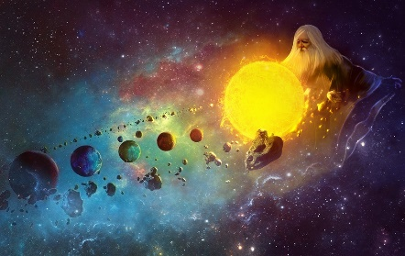
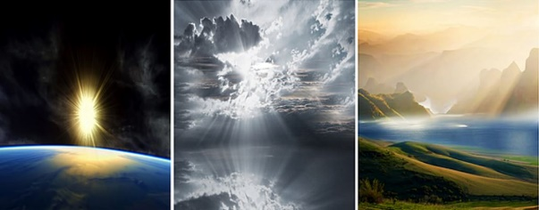
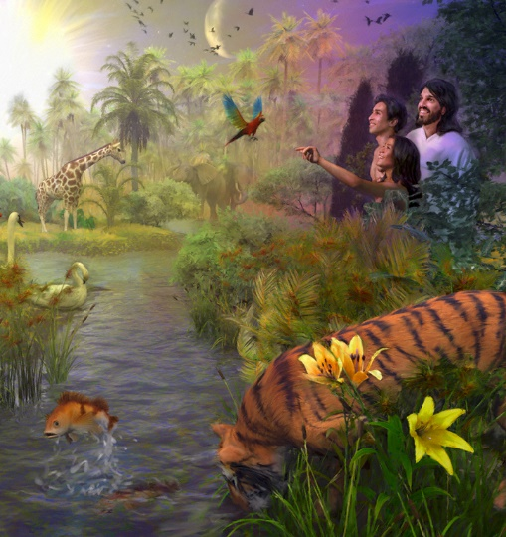
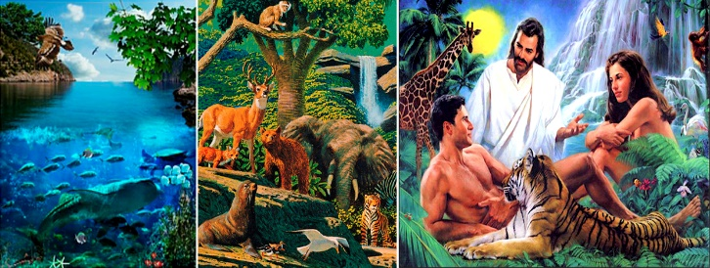
SABBATH AND CREATION (1)
“And on the seventh day God ended His work which He had done, and He rested on the seventh day from all His work which He had done.” (Genesis 2:2)
Creation began with an arid, dark, and lifeless world (Gn. 1:1-2). Little by little, other things like light, air, land, and vegetation were created.
Once the habitat was ready, God created the rhythms of the new world by placing several “clocks”: the Sun, the Moon, and the stars.
Finally, life filled the world during the following two days. Then God created a unique form of life in His image with special care: a man (‘ish) and a woman (‘ishshah). Everything is “very good.” (Gn. 1:31).
Creation was not done yet. After six days of creative activity, God rested. Note that the day of rest is considered part of the Creation week.

Slide 4
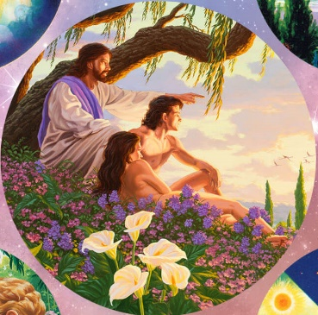
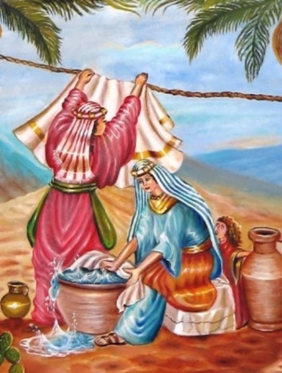
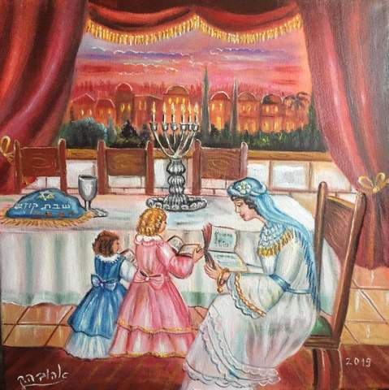
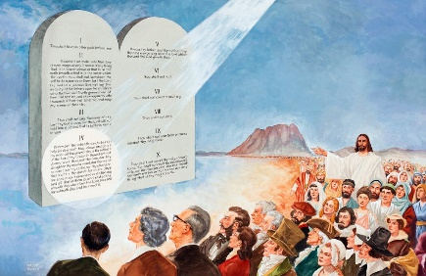
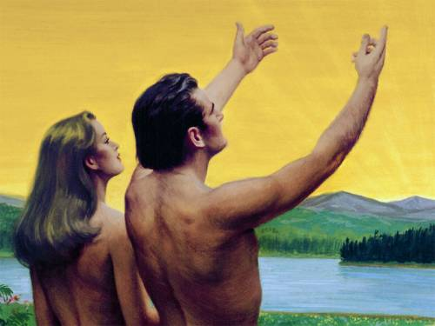
SABBATH AND CREATION (2)
“And on the seventh day God ended His work which He had done, and He rested on the seventh day from all His work which He had done.” (Genesis 2:3)
The last day of Creation was blessed and set apart for God’s creatures to have full communion with Him. Although the world was free from sin and stress, human beings needed to leave the daily tasks aside and spend a full day with their Creator.
When sin entered the world, pain, fragility, and harshness replaced joy and peace. Therefore, humans needed that day of rest to spend quality time with their Creator more than ever.
When God summarized His Law in the Ten Commandments, He included the Sabbath for us to rest and to remember that He created us (Ex. 20:8-11).

Slide 5
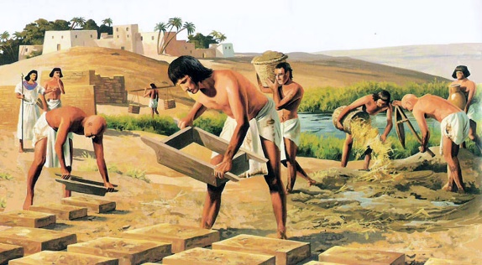
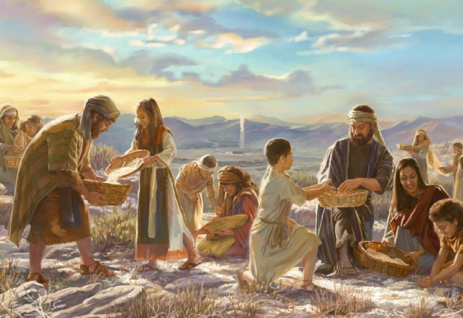
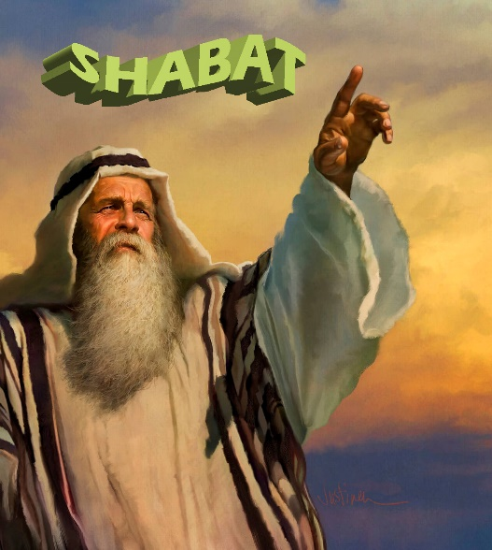
SABBATH AND REDEMPTION (1)
“Six days you shall gather it, but on the seventh day, the Sabbath, there will be none.” (Exodus 16:26)
Moses encouraged Israel to keep the Sabbath again before exiting Egypt. However, Pharaoh prevented it (Exodus 5:4-5).
The Sabbath is suddenly mentioned in Exodus 16, so the Israelites knew about it before. Once they had been liberated from Egypt and before arriving to Mount Sinai, God reminded them of the importance of the Sabbath rest through the miracle of manna.
God was linking the Sabbath rest with His love and care for them (Deuteronomy 8:3).
Moses mentioned the Sabbath again before the Israelites entered the Promised Land, linking it to Redemption.

Slide 6
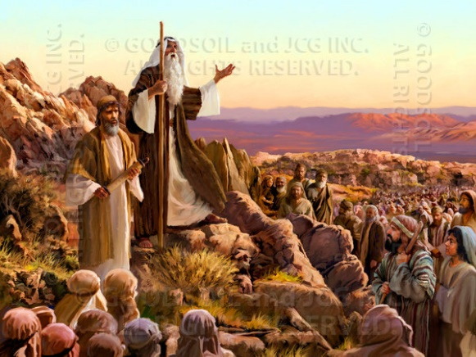
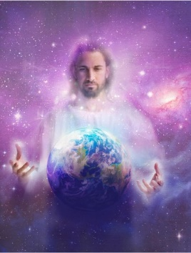
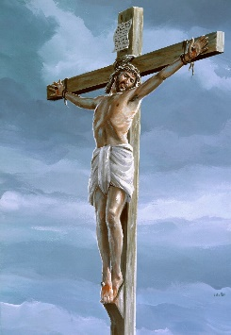
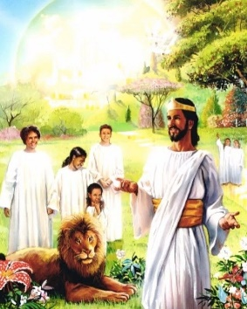
SABBATH AND REDEMPTION (2)
“And remember that you were a slave in the land of Egypt, and the Lord your God brought you out from there by a mighty hand and by an outstretched arm; therefore the Lord your God commanded you to keep the Sabbath day.” (Deuteronomy 5:15)
A new generation arose after almost 40 years of the Ten Commandments revelation at Mount Sinai. This new generation was willing to enter Canaan and the promised rest (Heb. 3:8-11, 16-19).
As they were going over the Commandments, the Sabbath was linked to God’s redeeming power this time (Dt. 5:12-15).
Therefore, the Sabbath is linked to the past [Creation], the present [Redemption], and the future [a New Creation for the redeemed] (Isaiah 66:23).
The Sabbath points to Jesus, our Creator and Redeemer. We will live forever with Him.

Slide 7
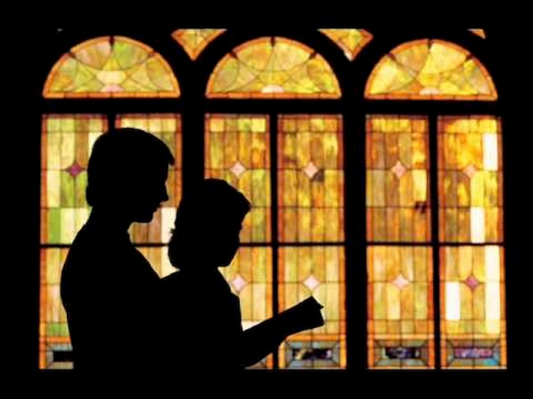
SABBATH AND REST
“If you turn away your foot from the Sabbath, from doing your pleasure on My holy day, and call the Sabbath a delight, the holy day of the Lord honorable, and shall honor Him, not doing your own ways, nor finding your own pleasure, nor speaking your own words.” (Isaiah 58:13)
How should I rest on Sabbath, according to Psalm 92, Exodus 16:29, and Isaiah 58:13?
Praise God (v. 1)
Speak to others about God (v. 2)
Sing to God (v. 3)
Rejoice in God’s Creation (v. 4-5)
Remember God’s righteousness (v. 6-9)
Find new strength in God (v. 10)
Meet God along with His Church (v. 13)
Spend time with your family and friends (Éx. 16:29)
Do not do your own will (Is. 58:13)
Enjoy the Sabbath (Is. 58:13)
Do not think or speak about your daily job (Is. 58:13)
“Then you will find your joy in the Lord.” (Isaiah 58:14)

Slide 8
“The Sabbath was not for Israel merely, but for the world. It had been made known to man in Eden, and, like the other precepts of the Decalogue, it is of imperishable obligation […] And when Eden shall bloom on earth again, God’s holy rest day will be honored by all beneath the sun.”
E. G. W. (The Desire of Ages, cp. 29, p. 283)

